Slide 1
The Color of Law and the Geography of Opportunity in West Oakland
SoBEO

Slide 2
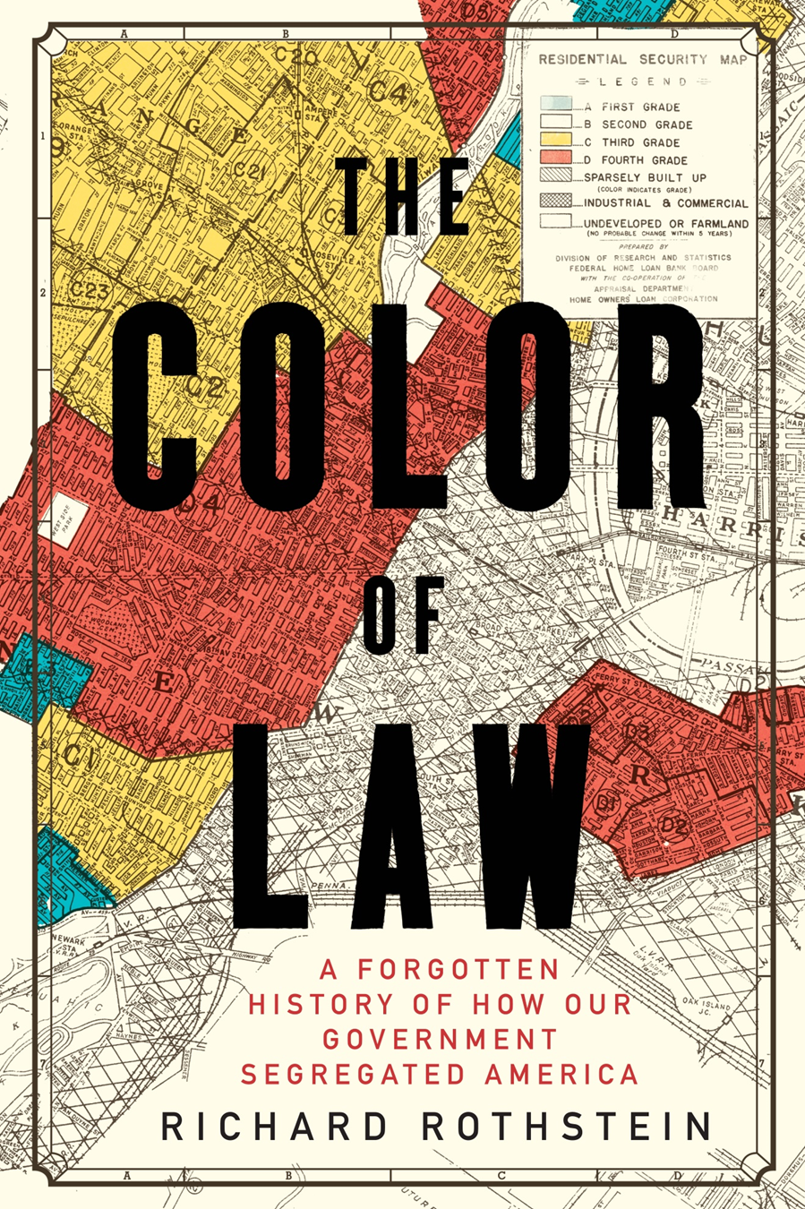

Slide 3
“An African-American born in West Oakland can expect to die almost 15 years earlier than a White person born in the Hills” –Alameda County Public Health Department Report

Slide 4
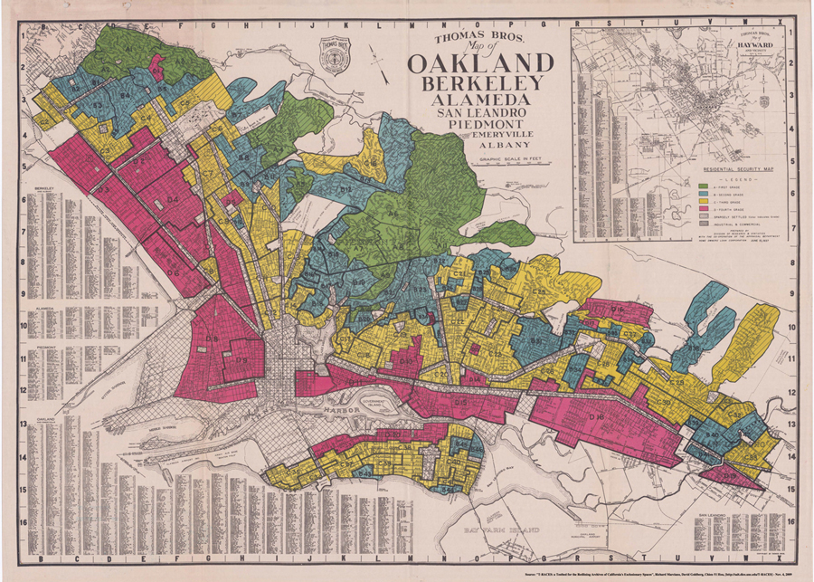
Redlining in Oakland Created Segregation that Still Affect us

Slide 5
Environmental Stress in Oakland

Slide 6
Asthma Rates

Slide 7
School Performance

Slide 8
4 schools 4 miles apart- chasms of opportunity
School | School A | School B | School C | School D
Free/reduced lunch | 92% | 1% | 74% | 8%
Reading proficiency | 0% | 89% | 13% | 79%
Math Proficiency | 1% | 88% | 15% | 78%
Driving Distance form School A in miles | N/A | 3.7 | 4.0, less than .5 miles from school B | 6.6
% African American | 62.7% | 1.9% | 53.5% | 7.4%

Slide 9
Urban Redevelopment Hurt West Oakland
The ORA’s first project would be telling of its character: the Acorn Project designated about 50 blocks in West Oakland for demolition, including parts of the historic heart of black Oakland, 7th Street. On top of that, construction did not begin in Acorn until five years after demolition was completed, leaving a giant barren area in the middle of West Oakland. By the mid 60s, the demolition policies of the ORA would create deep scars in the black neighborhoods close to downtown[10].

Slide 10
A Scar in the Middle of the Black Community

Slide 11
Redevelopment Helps the Suburbs not the West
The construction of the Cypress freeway portion of I-880 further upset West Oakland. This project, completed in 1958, demolished properties through the neighborhood in a north-south strip, pushing families out and physically segregating the westernmost section from the rest of the city. : THE CHANGING FACE OF OAKLAND 1945-199O
between 1960-66, urban renewal, freeway construction, BART construction, and other government action destroyed over 7,000 housing units in Oakland, almost 5,100\ of which were located in West Oakland[12].

Slide 12
Housing Policy Hurt
The Housing Act of 1949, under eminent domain, condemned to destruction the homes of Blacks that had fallen to disrepair. Dozens of blocks of homes were bulldozed to the ground to make room for housing projects like Acorn, which alone displaced approximately nine thousand residents. Four hundred more homes and business were demolished in 1960 to make room for the construction of a U.S Postal Service distribution center .(19) The Black residents that were once pushed into West Oakland were now being forced out, taking with them the wealth and culture that created the allure of Seventh Street.
http://www.foundsf.org/index.php?title=The_Rise_and_Fall_of_Seventh_Street_in_Oakland

Slide 13
The FHA Created the Ghetto
Important precedents were made in housing stock patterns and in racial segregation of housing units. The FHA promoted construction of all-white suburban developments, and were not afraid to use racial covenants to carefully control the racial composition in the new developments. This left the numerous new black families of Oakland with few options. Overcrowding in West Oakland, the traditional black hub of the city, became a problem: instance of overcrowding doubled in West Oakland between 1940 and 1950 [5]. Racial homogeneity increased in West Oakland as well: THE CHANGING FACE OF OAKLAND 1945-199O

Slide 14
Racial Zoning Outside of Oakland Affects Oakland
San Leandro, the suburban community bordering Oakland to the south, turned its covenants into “neighborhood protective associations,” or groups of homeowners that determined who could live in their neighborhood as long as “race and creed” were not taken into account. Such associations were extremely effective in maintaining San Leandro’s racial exclusivity and protecting property values. By 1970 blacks comprised thirty-four percent of Oakland’s population, while just eighty-four blacks lived in San Leandro, comprising just over one percent of the population. In 1980 the average house in San Leandro was worth $96,400, thirty thousand dollars more than the average house in Oakland--Title: A Tale of Two Cities: How the Government Caused and Maintained Racial Inequality in Oakland, California 1945- 1970

Slide 15
The FHA and Segregation Part 2
the Federal Housing Administration’s Title 6 program guaranteed loans for private construction, but was restricted to white buyers doing little to help those of color. Thus, white suburban neighborhoods arose, many of which were built outside of the city limit in an attempt to avoid municipal building codes. With little assistance from the private sector, Blacks remained in West Oakland and relied on public housing programs. Claims of racial conflict by Oakland Housing Authority, however, necessitated segregation of these programs. Four all-Black projects were built in West Oakland, while corresponding white projects were built along bay flats in East Oakland.(11) http://www.foundsf.org/index.php?title=The_Rise_and_Fall_of_Seventh_Street_in_Oakland

Slide 16
Blacks relied on public housing but little was available
In 1966, though an estimated 20,000 people were eligible for public housing in the city, Oakland had just 1,422 permanent public housing units[14].

Slide 17
Changing Demographics in West Oakland
The median income for African American, Latino, and Asian households in Oakland has declined since 2000. Citywide, White households had nearly double the median household income of any other racial or ethnic group,19 and Oakland was recently ranked as having the seventh-highest income inequality among cities in the nation.20 This income stratification will likely continue given labor market trends without significant interventions.
http://www.policylink.org/sites/default/files/pl-report-oak-housing-070715.pdf

Slide 18
Blacks are now the third largest racial group in Oaklnd

Slide 19
The Challenges of Affordability
Zillow’s analysis shows that African Americans could afford just five percent of the region's home listings in 2017 - the lowest percentage in the entire country, the data showed, compared to 42 percent for all homebuyers in San Francisco and Oakland.

Slide 20
Academic Challenges for our Youth

Slide 21
“An African-American born in West Oakland can expect to die almost 15 years earlier than a White person born in the Hills” –Alameda County Public Health Department Report

